Slide 1

Software Engineering Lecture # 1
Quratulain
Lecturer
Department of Computer Science

Slide 2
Course Objective
To familiarize students to the fundamental concepts, techniques, processes, methods and tools of Software Engineering,
To help students to develop basic skills that will enable them to construct software of high quality – software that is reliable, and that is reasonably easy to understand, modify and maintain
To foster an understanding of why these skills are important

Slide 3
Lecture Objectives
To introduce software
To introduce Software Engineering
To describe Software Evolution
To describe Software Paradigms
To describe need of Software Engineering
To describe the qualities of good Software

Slide 4
 | Topics | Description
1 | Introduction to the Course and Software Engineering | Lay out of the course and overall introduction of the discipline of Software Engineering and what we will cover in the course.
2 | Software Processes & Software Process Models | General introduction of processes and software engineer processes. Discussion of different process models and their practical implications. These process models include Waterfall model, evolutionary models and incremental models.
3 | Software Process Models (continued); Analysis modeling | Software process models will be completed in the first lecture of this week. Analysis phase of software engineering will be introduced.
4 | Scenario based modeling | Analysis modeling approaches (Object oriented analysis; Flow oriented analysis).Topics will include requirement gathering using use case diagrams, Activity diagrams, Swim lane diagrams.

Slide 5
5 | Flow oriented modeling | Data flow diagrams, Control flow diagrams, processing narratives
6 | Behavioral modeling | State diagrams, Sequence diagrams
7 | Class Diagrams | How to create initial domain model and how to develop conceptual class diagram. Usefulness of domain model.
8 | Software Design | General Introduction of Object Oriented Design techniques and methods
9 | Software Architecture | Discussion of need of explicitly defining software architecture and its benefits. What are important determinant of selection of certain architecture or architecture style. Cost and benefit analysis of well know architectural style

Slide 6
10 | Source Code Management | What are coding standards how essential they are? Discussion of software configuration management process
11 | Software Testing | What is software testing process, what methods, tools and techniques are use to verify and validate the software. How software testing process is distributed over entire life cycle of software development.
12 | Software Maintenance | What happen between software is deployed till the time it is retired. How software evolution occurs and how it is managed.
13 | Software Quality | What is software quality, how can we ensure that software we develop is of acceptable quality. Software quality assurances imperatives.
14 | Software Business and Ethics | Business of software is fast become a major GNP producer. Many rules and regulation are there to guide software industry. How business and regulation software engineering practices. (Special Reading)

Slide 7
Motivation

Slide 8
Software can have huge impact in any aspect of our society

Slide 9
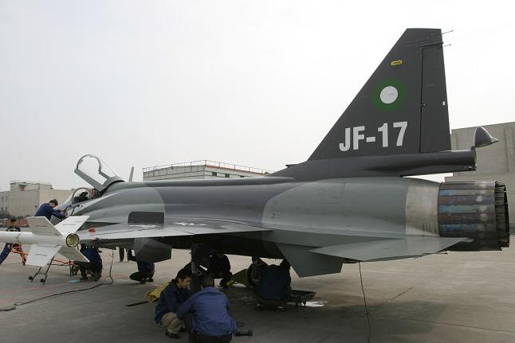
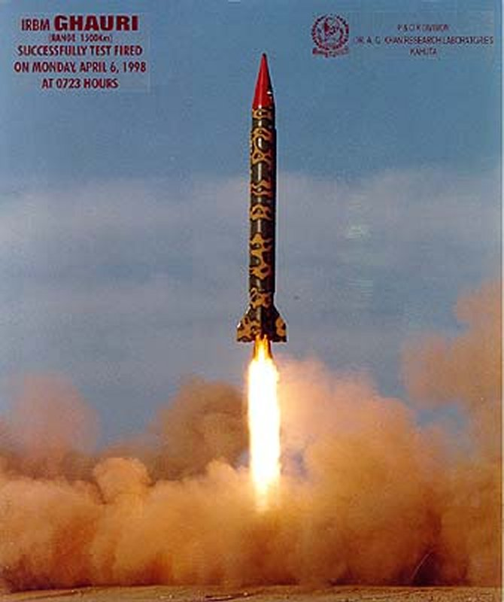
Where can we find software?

Slide 10
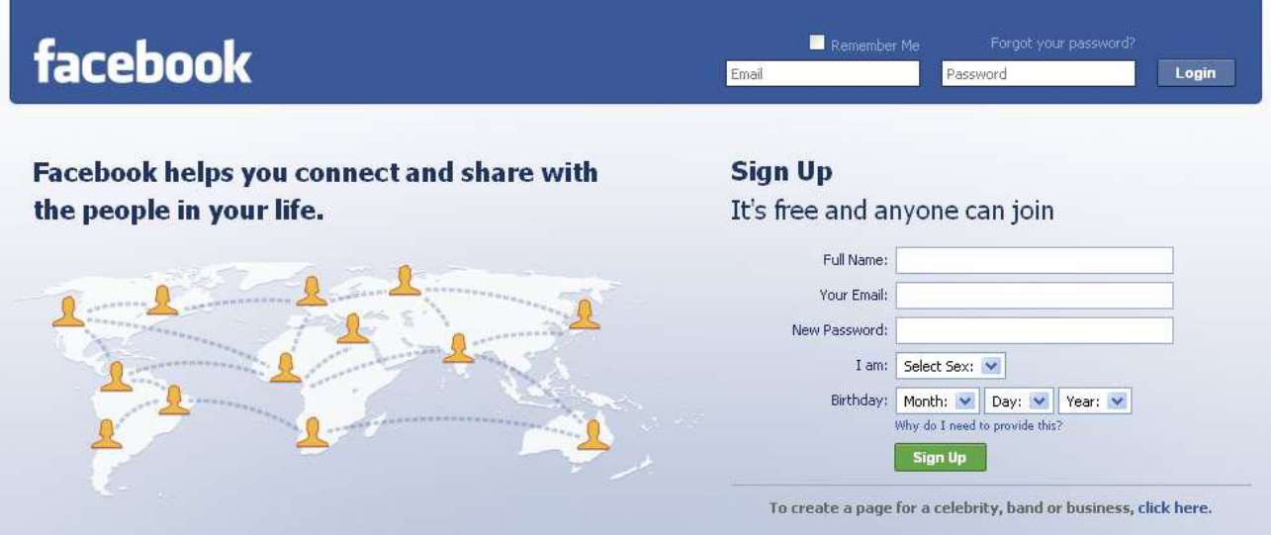
Some popular ones…

Slide 11
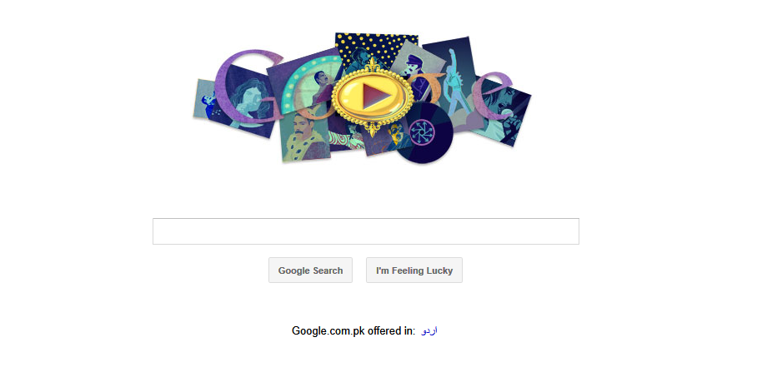
Some popular ones…

Slide 12

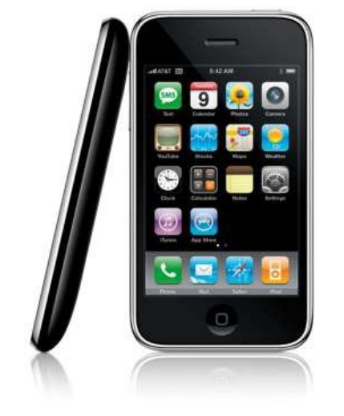
And even in…

Slide 13
Conclusion
Software is almost everywhere!!!

Slide 14
Problems in software development
Common issues
The final software does not fulfill the needs of the customer
Hard to extend and improve: if you want to add a functionality later its mission impossible
Bad documentation
Bad quality: frequent errors, hard to use, ...
More time and costs than expected

Slide 15
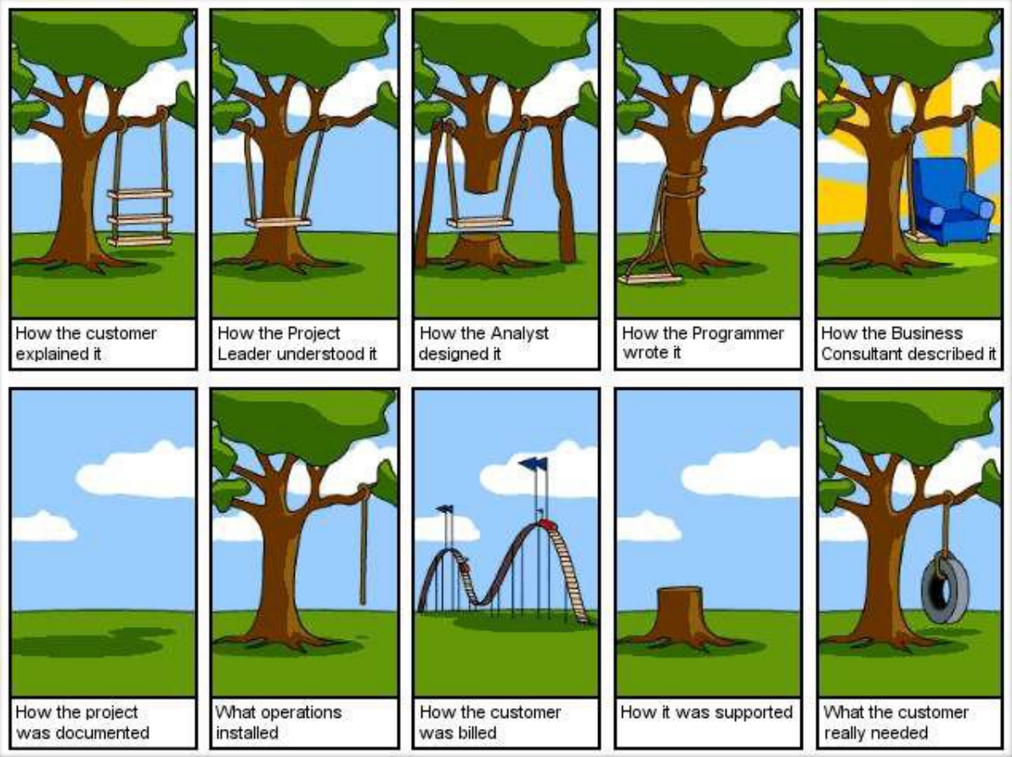

http://www.projectcartoon.com

Slide 16
But
that never happens?
right?

Slide 17
Wrong!

Slide 18
Ariane 5 Flight 501
Cause: design errors in the software
http://www.youtube.com/watch?v=kYUrqdUyEpI

Slide 19
Conclusion
Programming is NOT enough!
It is not enough to do your best: you must Know what to do, and THEN do your best. -- W. Edwards Deming

Slide 20
And Since…
A clever person solves a problem.
A wise person avoids it.
- Albert Einstein

Slide 21
Solution

Slide 22
Software Engineering
The application of a systematic, disciplined, quantifiable approach to the development, operation, and maintenance of software; that is the application of engineering to software.
The study of approaches as in (1)
-- IEEE Definition (1993)

Slide 23
Software Engineering
Objective is to produce software that is:
On time: is deliver at the established date.
Reliable: does not crash.
Complete: good documentation, fulfill customer needs.

Slide 24

Questions
Any Question Please?
You can contact me at: quratulain@uosahiwal.edu.pk
Your Query will be answered within one working day.

Slide 25
Further Readings
Software Engineering by Ian Sommerville, Chapter 1.
New Software Engineering by Sue Conger, Ch. 1 Pages: 1-5

Slide 26
Thanks

